Slide 1
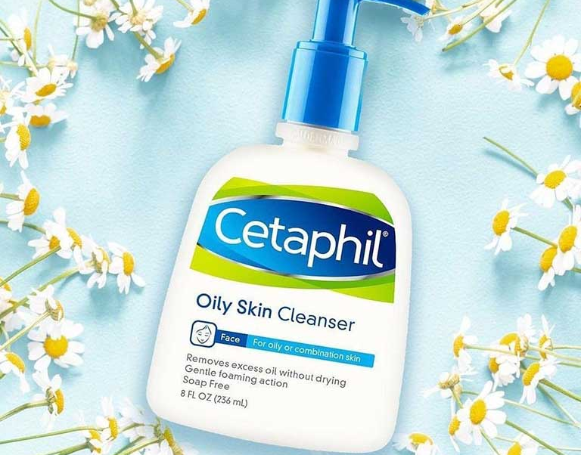
COMPETITIVE ANALYSIS
Presented by,
Rijo Joy
Feba K Johnykutty
Nandana K Vinayan
Mohammed I

Slide 2
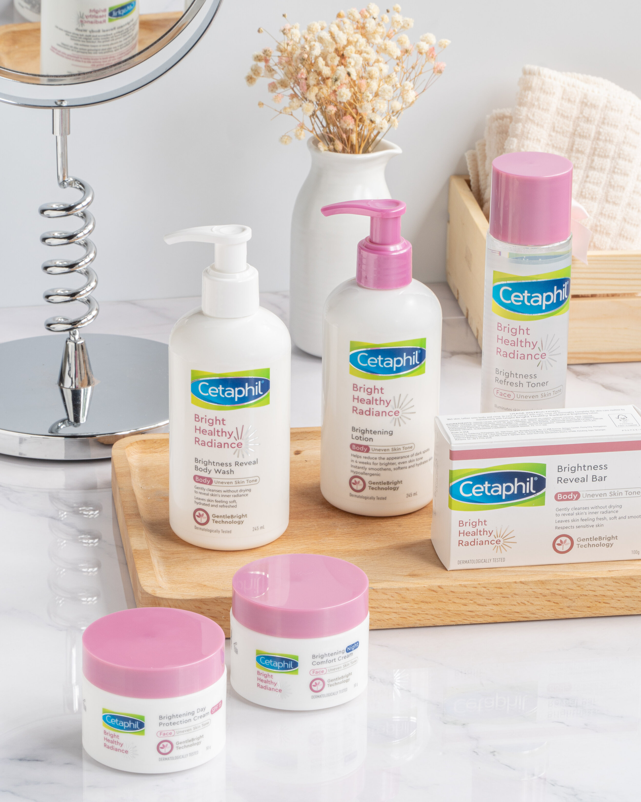
CONTENTS
Introduction
Objectives
Market Overview
History
Comparison With Competitors
Pros &Cons
Distribution Channels
Market Strategy
Future Recommendations
Conclusion

Slide 3
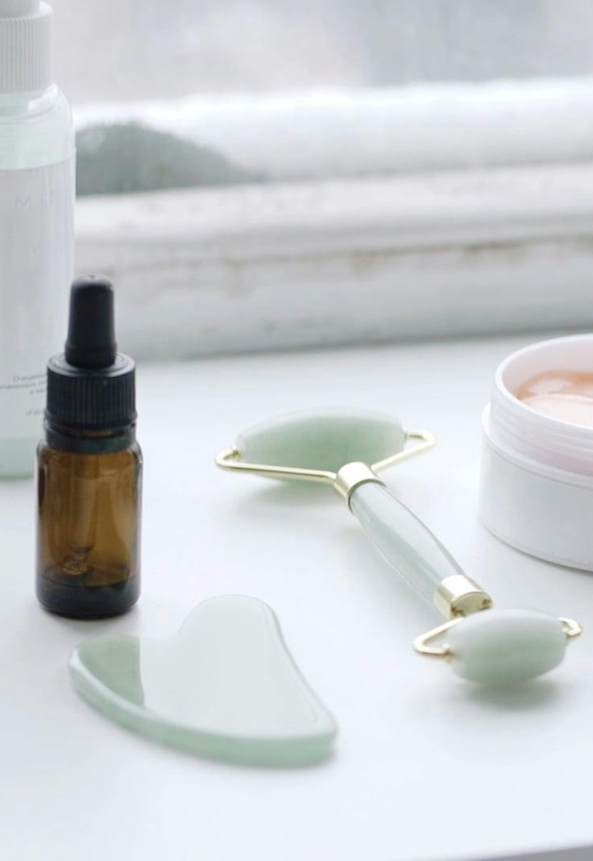
INTRODUCTION
The Indian skin care market is growing rapidly, fueled by increased consumer awareness and a rising demand for premium products. Cetaphil, a globally recognized brand, is strategically positioned to benefit from this trend with its gentle, dermatologist-recommended offerings. This analysis covers Cetaphil's market standing, key industry trends, competitive environment, and its growth strategies aimed at expanding its presence in the evolving Indian skin care sector.
16:59
The Indian skin care market is growing rapidly, fueled by increased consumer awareness and a rising demand for premium products. Cetaphil, a globally recognized brand, is strategically positioned to benefit from this trend with its gentle, dermatologist-recommended offerings. This analysis covers Cetaphil's market standing, key industry trends, competitive environment, and its growth strategies aimed at expanding its presence in the evolving Indian skin care sector.

Slide 4
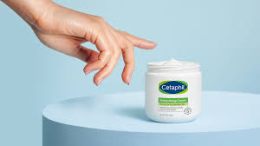
OBJECTIVES
Identify competitors
Analyze SWOT
Assess market share
Evaluate products & pricing
Recommended growth strategies

Slide 5
MARKET OVERVIEW
Market Size (2020): The Indian skincare market was valued at ₹134.8 billion in 2020, indicating a substantial size within the broader personal care industry.
Projected Growth Rate (2020-2025): The market is expected to grow at a Compound Annual Growth Rate (CAGR) of 8.5% from 2020 to 2025. This growth rate reflects a steady increase in demand and consumer spending on skincare products.
Expected Market Size (2025): By 2025, the Indian skincare market is projected to reach ₹223.4 billion. This significant growth highlights the expanding consumer base and increasing interest in skincare products in India.
Market Segmentation :

Slide 6
Regional Analysis:
Market Trends:
Growing Demand for Gentle, Non-Comedogenic Products.
Increasing Awareness of Skin Health and Wellness.
Rising Popularity of Fragrance-Free Products.

Slide 7
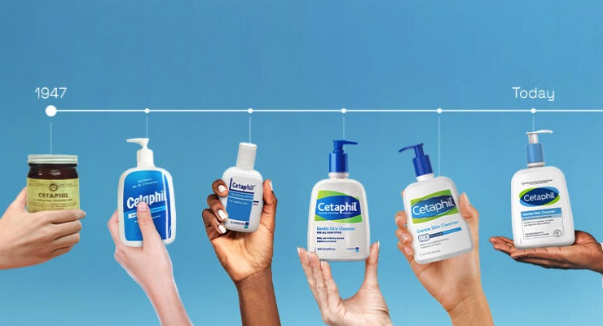
HISTORY
Cetaphil was developed in 1947 by Dr. Sidney Milstein and Galderma Laboratories, originally as a gentle cleanser for sensitive skin. The brand quickly gained popularity due to its dermatologist-recommended products. Over the years, Cetaphil expanded its range to include various cleansers, moisturizers, and sunscreens. Its focus on non-irritating, effective formulations has made it a staple in dermatology. Today, Cetaphil is recognized globally for its reliable skincare solutions suited to all skin types.

Slide 8
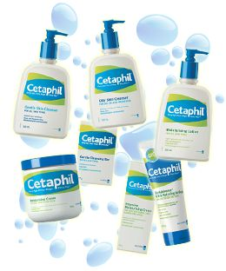
CETAPHIL PRODUCT CATEGORIES:
Cleansers
Moisturizers.
Sun Care
Skin Care (Anti-aging, Acne, Hydrating)
Baby Care
Sensitive Skin (Fragrance-free, Hypoallergenic)
Specialty Products (Wound Care, Scar Treatment)

Slide 9
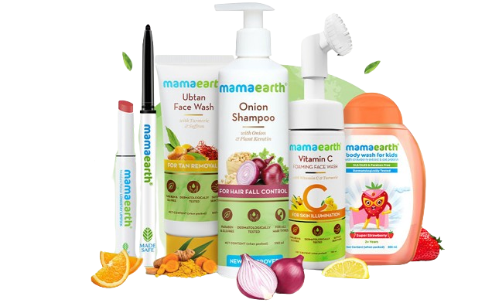
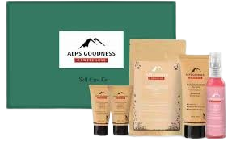
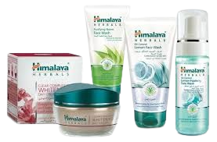
COMPARISON WITH COMPETITORS

Slide 10
Cetaphil
Mamaearth
Combines natural ingredients with a focus on sustainability and ethical practices with a price range that’s generally mid to premium
Cetaphil is best for all skin types looking for dermatologist approved ,non-irritating products.
Himalaya
Alps Goodness
Offers natural ,Ayurvedic product at a budget friendly price
Provides a range of natural and organic product at a mid range price point

Slide 11
Clinical Testing

Slide 12
Dermatologist Recommendation

Slide 13
Customer Loyalty

Slide 14
Average Price Comparison

Slide 15
PROS & CONS
Pros | Cons
Gentle formulation Non-Comedogenic Dermatologist Recommended Suitable for all skin types Affordable Available world wide | Fragrance free Price variability No luxurious feel Lack of multi–step solutions

Slide 16


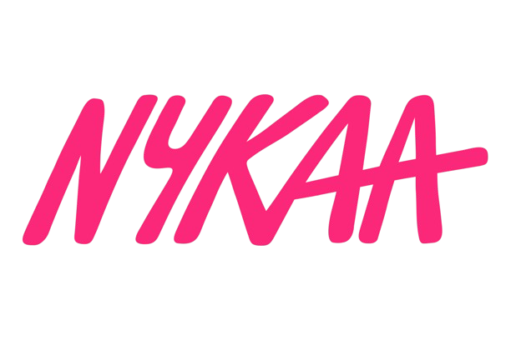

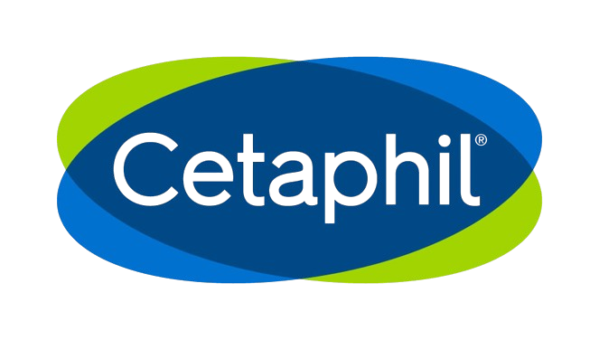
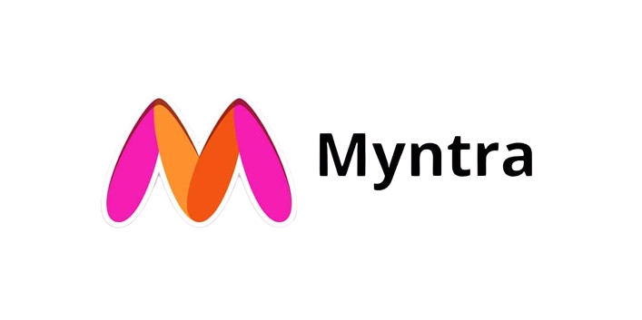
DISTRIBUTION CHANNELS
Retail stores
Online platform
Pharmacies
Dermatologist and healthcare professionals

Slide 17

MARKETING STRATEGY
Digital marketing
Sponsorship of dermatology events
Partnerships with dermatologists and healthcare professionals
Online presence through website and social media
Product sampling and loyalty programs
Educational content and workshops

Slide 18

FUTURE RECOMMENDATIONS
Expand product line for specific skin concerns
Enhance digital marketing
Collaborate with popular skincare influencers and bloggers
Invest in research and development for innovative ingredients
Strengthen presence in emerging markets
Offer personalized skincare consultations and services
Monitor and adapt to changing consumer preferences and trends

Slide 19
CONCLUSION
Cetaphil effectively leverages its reputation for gentle, dermatologist-recommended skincare, positioning itself well in the market. To strengthen its competitive position, Cetaphil should focus on product innovation, expanding its range, and enhancing digital engagement. This strategies will help the brand address evolving consumer needs and maintain its market presence.

Slide 20
REFERENCES
https://www.cetaphil.com/us/why-cetaphil/science-based-skincare.html
Cetaphil key Insights and data from Google and YouTube.

Slide 21


THANK YOU!

